Slide 1
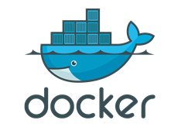
The Dockerfile, Builds and Network Configuration

Slide 2
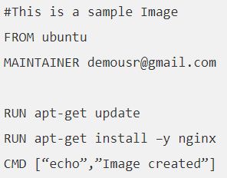
Overview of Dockerfile
Docker can build images automatically by reading the instructions from a Dockerfile.
A Dockerfile is a text document that contains all the commands a user could call on the command line to assemble an image.
Notes:
Key Points:
A Dockerfile is a text document that contains all the commands a user could call on the command line to assemble an image. From using a base Docker image, to adding and copying files, running commands, and exposing ports.
You can consider the Dockerfile to be "source code" and images to be the "compiled code" for your containers, which are the "running code".
Dockerfiles are highly portable and can be shared, stored, and updated.

Slide 3
Dockerfile
Create images automatically using a build script: «Dockerfile»
Can be versioned in a version control system like Git or SVN, along with all dependencies
Extends from a Base Image and Results in a new Docker Image
A Docker file lists the steps required to build an image
From command defines base image
Each subsequent command adds a layer
docker image build .. Builds image from Dockerfile
Notes:
Key Points:
A Dockerfile is a text document that contains all the commands a user could call on the command line to assemble an image. From using a base Docker image, to adding and copying files, running commands, and exposing ports.
You can consider the Dockerfile to be "source code" and images to be the "compiled code" for your containers, which are the "running code".
Dockerfiles are highly portable and can be shared, stored, and updated.

Slide 4

Build Context
Directory archive
Must contain all local files necessary for image
Will omit anything listed in .dockerignore

Slide 5


Examining the build process
Launch a new container based on the image thus far
Execute command in that container
Commit R/W layer to image
Delete intermediate container

Slide 6
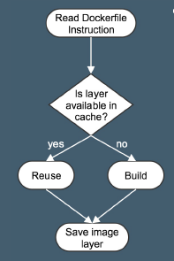
Build Cache
After completion, the resulting image layer is labeled with a hash of the content of all current image layers in the stack.

Slide 7
USER and RUN
If the user specifies arguments to docker run then they will override the default specified in CMD.
Is it necessary to specify which user before perform a RUN?
USER root
RUN commandA
USER www
RUN commandB
……
RUN commandC

Slide 8
RUN vs CMD
RUN is an image build step, the state of the container after a RUN command will be committed to the docker image. A Dockerfile can have many RUN steps that layer on top of one another to build the image.
CMD is the command the container executes by default when you launch the built image. A Dockerfile can only have one CMD. The CMD can be overridden when starting a container with docker run $image $other_command.

Slide 9
Env
ENV <key> <value>
ENV <key>=<value> ...
The ENV instruction sets the environment variable <key> to the value <value>.
This value will be in the environment for all subsequent instructions in the build stage and can be replaced inline in many as well.

Slide 10
Cmd and Entrypoint
CMD alone: default command and list of parameters.
CMD + ENTRYPOINT: ENTRYPOINT provides command, CMD provides default parameters.
CMD overridden by command arguments to docker container run
ENTRYPOINT overridden via --entrypoint flag to docker container run.

Slide 11

SHELL vs EXEC format

Slide 12
COPY and ADD commands
COPY copies files from build context to image:
ADD can also untar and fetch URLs. In both cases
create checksum for files added
log checksum in build cache
Cache invalidated if checksum changed

Slide 13


ENV and ARG commands
ENV sets environnent variables Inside of the container:
ARG defines arguments that can be passed in from the command line during build:

Slide 14
EXPOSE
EXPOSE <port> [<port>/<protocol>...]
The EXPOSE instruction informs Docker that the container listens on the specified network ports at runtime.
You can specify whether the port listens on TCP or UDP, and the default is TCP if the protocol is not specified.
To expose on both TCP and UDP, include two lines:
EXPOSE 80/tcp
EXPOSE 80/udp

Slide 15
Dockerfile Commands Summary
FROM: base image to start from
RUN: run a command in the environment
CMD and ENTRYPOINT: define default behavior
COPY and ADD: copy files into container
ENV: define environment variables inside a container
ARG: define build time arguments
https://docs.docker.com/engine/reference/builder/#dockerfile-examples

Slide 16
Docker Volume
Containers often require storage for using, capturing, or saving data beyond the container life cycle.
Utilizing volume storage is best to keep data for future use or permit shared consumption by other containers or services.
The many volume storage solutions available provide features such as high availability, performance, sharing, and reliable read/write filesystem protocols that are supported by Docker, OS vendors, and storage vendors.

Slide 17
Docker Volume
Docker can use 2 main methods for storage
Host-based - The container with either use the native filesystem from the host it is currently on, or the native filesystem on another host.
Volume Plugins – Docker has support for plugins to interact with 3rd party storage solutions. This allows the Docker to take advantage of the features of these storage solutions.

Slide 18
Host Based Storage
For host based storage the containers depend on the underlaying host for the volume storage.
This bypasses the union filesystem used for the container image on the host and exposes the native filesystem of the host directly.
This data is resides outside of the container, so can be available after the container is removed.
In host bases persistence, multiple containers can share one or more volumes.

Slide 19
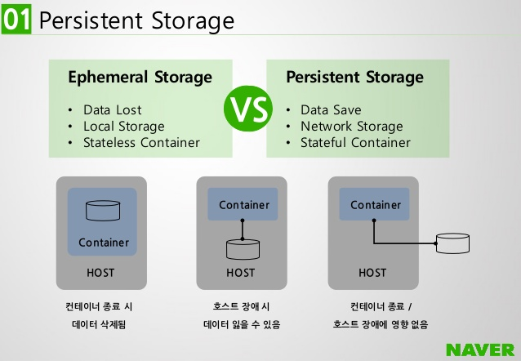
Implicit Per Container Storage
When the container gets started, implicit storage is created on the host the container will run on.
This storage is by default in the directory /var/lib/docker/volumes
This storage is tied to the life of the container. When the container is removed, the storage is removed.

Slide 20
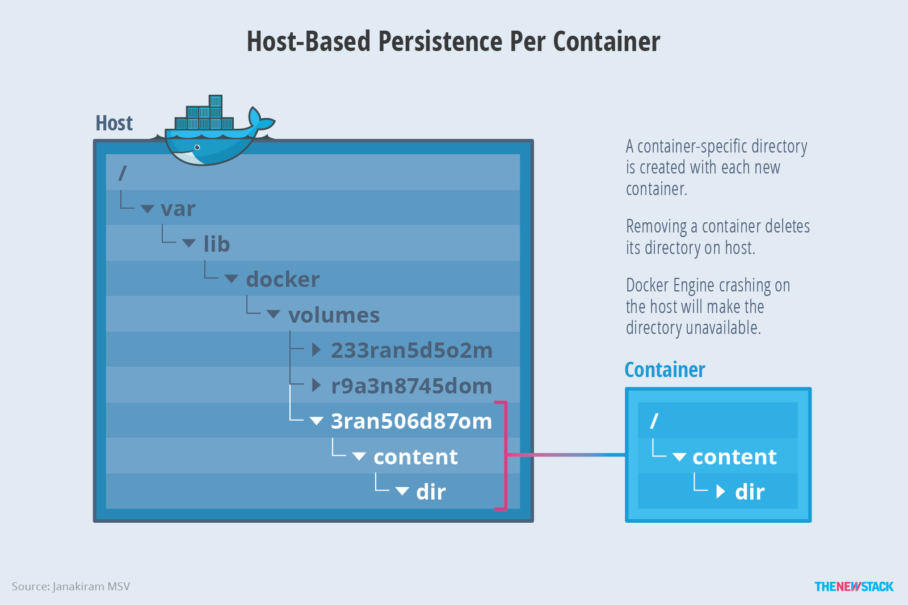
Implicit Per Container Storage

Slide 21
Explicit Shared Storage
A second option is available is the storage needs to be accessed by multiple containers running on the same host.
The location of the storage on the host is exposed as a mount within one or more containers
This volume can then be read and written to by multiple containers on the same host
The volume is not deleted when the containers are removed, and is persistent.
There is no file locking mechanism, so applications must be written to account for this.

Slide 22
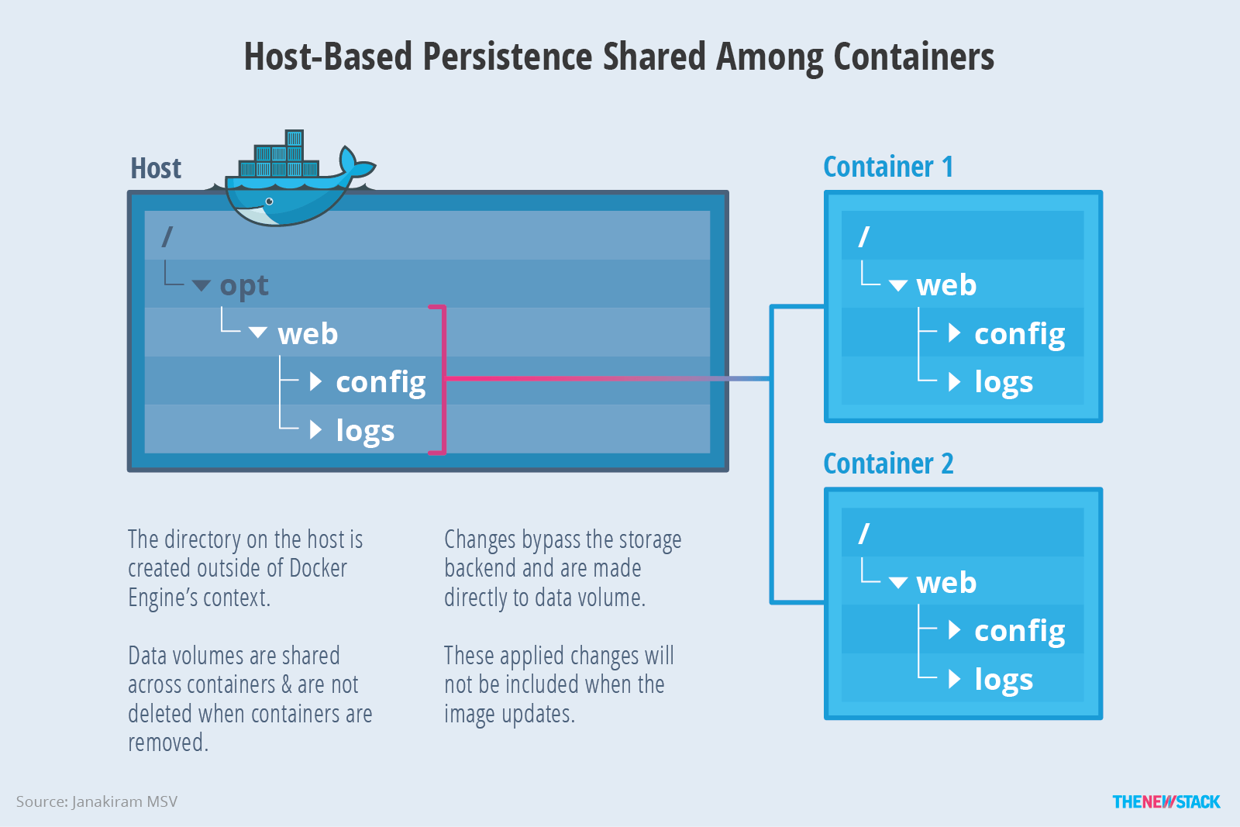
Explicit Shared Storage

Slide 23
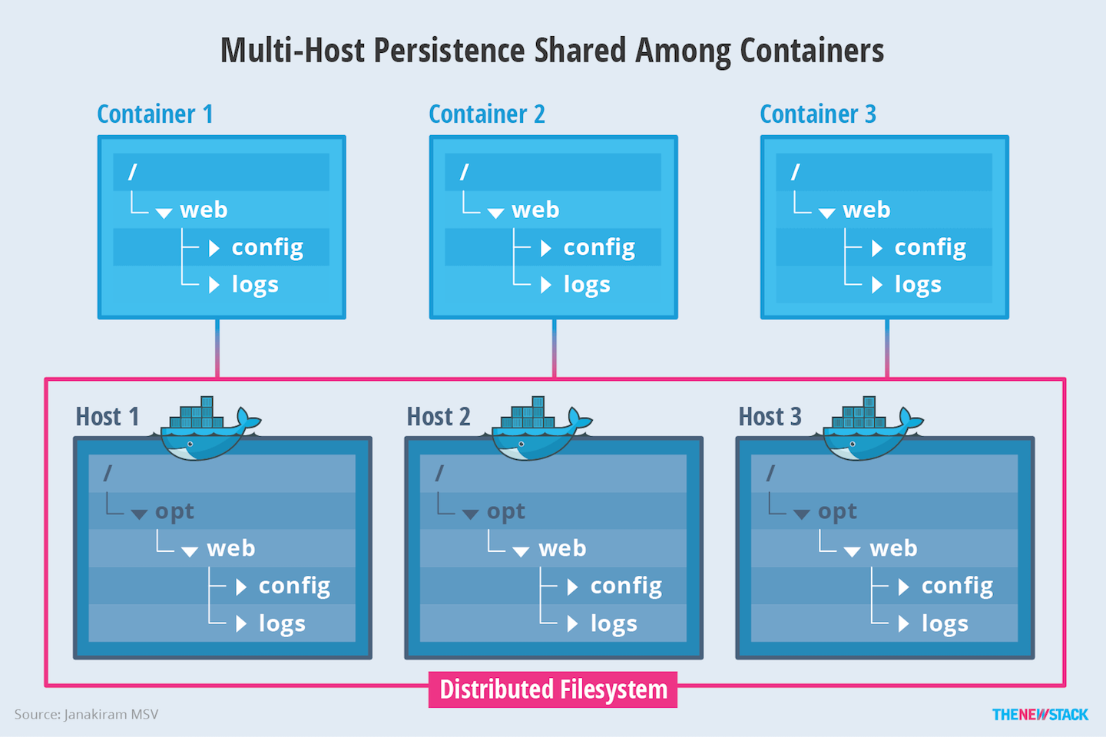
Shared Multi Host Storage

Slide 24
Volume Plugins
In order to fully take advantage of the containers portability, and storage vendor features, volume plugin were enabled.
Starting with version 1.8, Docker added support for 3rd party plugins
This enables the engine deployments to be integrated with external storage systems and volumes to persist beyond the lifetime of a single engine host.

Slide 25
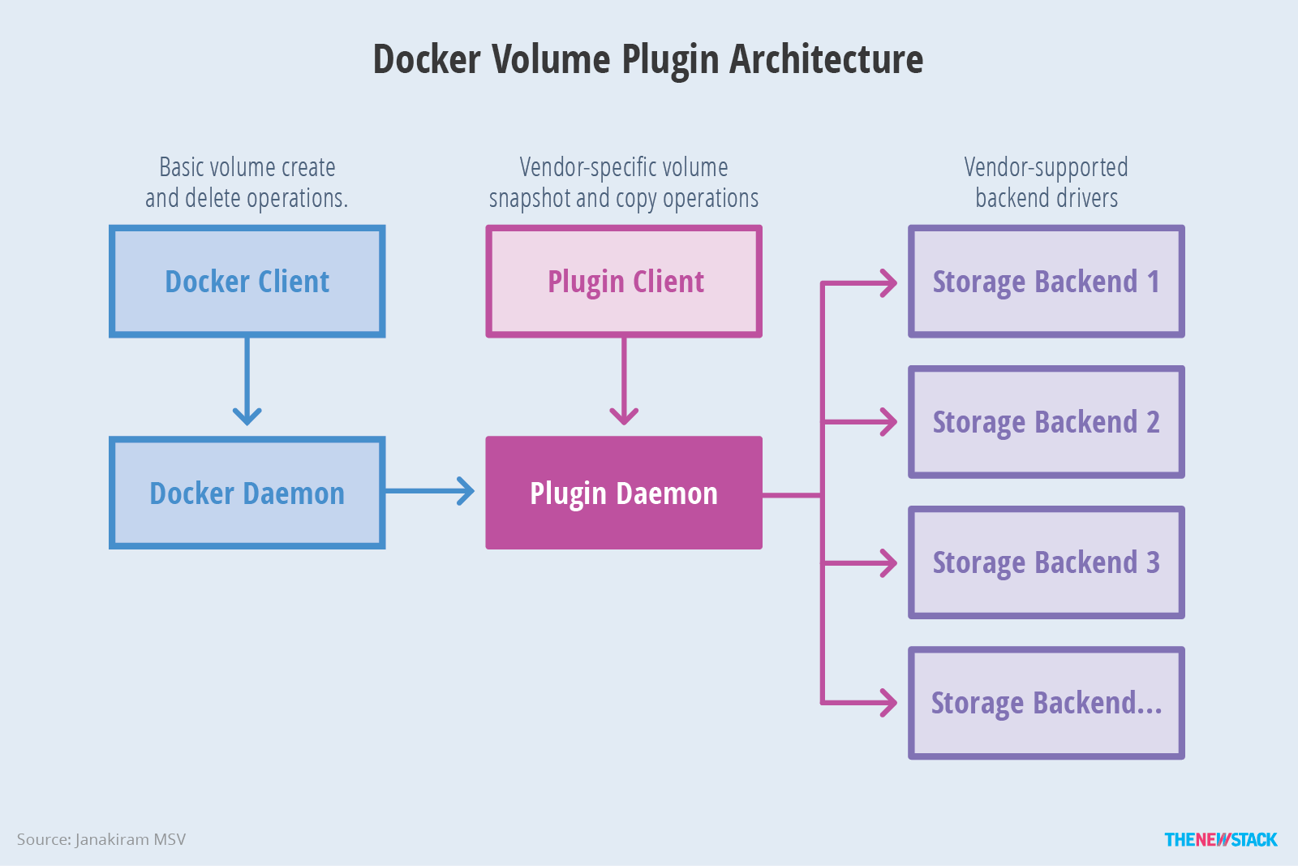
Volume Plugins

Slide 26
Docker Volume Management Commands
docker volume ; manage volumes
docker volume create <name> ; create a volume
docker volume ls ; list volumes
docker volume inspect <name> ; look at attributes of a volume
docker volume rm <name> ; remove a volume
docker run ; start a container with a volume
docker run –d –name <container name> --mount source=<vol name>,target=<where to mount> <image name>
docker inspect <container name> ; to see the mount

Slide 27
Docker Shared Volume Management Commands
docker plugin install –grant-all-permissions <plugin> ; install appropriate plugin
docker volume create –driver <plugin type> -o sshcmd=<user@node:directory> -o password=<password for user> <volume name> ; create a volume on a remote host/remote storage
docker run –d –name <container name> --volume-driver=<plugin type> --mount src=<remote volume name>,target=<mount point>,volume-opt=sshcmd=<user@node:directory>,volume-opt=<password> <image name> ; start a container with a remote volume mounted

Slide 28
Docker Network
Manage networks
Subcommands to create, inspect, list, remove, prune, connect, and disconnect networks.

Slide 29
Docker Network List
List networks
docker network ls [OPTIONS]
Name, shorthand | Description
--filter , -f | Provide filter values (e.g. ‘driver=bridge’)
--format | Pretty-print networks using a Go template
--no-trunc | Do not truncate the output
--quiet , -q | Only display network IDs

Slide 30
Docker Network Inspect
Display detailed information on one or more networks
docker network inspect [OPTIONS] NETWORK [NETWORK...]
Name, shorthand | Description
--format , -f | Format the output using the given Go template
--verbose , -v | Verbose output for diagnostics

Slide 31
Docker Network Create
Create a network
docker network create [OPTIONS] NETWORK
Name, shorthand | Description
--attachable | Enable manual container attachment
--aux-address | Auxiliary IPv4 or IPv6 addresses used by Network driver
--config-from | The network from which copying the configuration
--config-only | Create a configuration only network
--driver , -d (bridge by default) | Driver to manage the Network
--gateway | IPv4 or IPv6 Gateway for the master subnet

Slide 32
Docker Network Create
Name, shorthand | Description
--ingress | Create swarm routing-mesh network
--internal | Restrict external access to the network
--ip-range | Allocate container ip from a sub-range
--ipv6 | Enable IPv6 networking
--label | Set metadata on a network
--subnet | Subnet in CIDR format that represents a network segment

Slide 33
Docker Network Remove
Remove one or more networks
docker network rm NETWORK [NETWORK...]

Slide 34
Docker Network Assign to container
Connect a container to a network
docker network connect [OPTIONS] NETWORK CONTAINER
Name, shorthand | Description
--ip6 | Add network-scoped alias for the container
--ip | IPv4 address (e.g., 172.30.100.104)
--ip6 | IPv6 address (e.g., 2001:db8::33)
--link | Add link to another container
--link-local-ip | Add a link-local address for the container

